Slide 1

Workshop: Introduction to Analysis Data Model (ADaM) Spencer Renyard

Slide 2
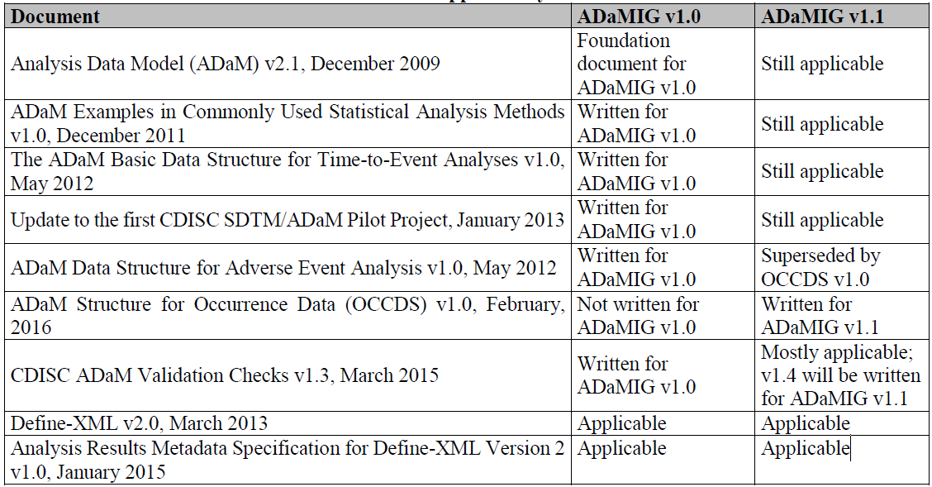
ADaM-Related CDISC Documents
Notes:
Table 1.3.1.1 ADaM IG 1.1

Slide 3
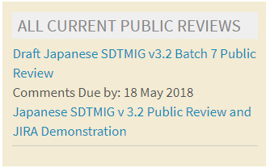
Current Work of ADaM Team
The ADaM Team is currently working on additional ADaM standard documents addressing the following topics:
Integration of multiple studies
Pharmacokinetics
Oncology
Questionnaires, Ratings, and Scales
Some CDISC Therapeutic Area User Guides (TAUGs) are released in draft, provisional, or final versions that discuss analysis and propose approaches to ADaM implementation
Notes:
Some CDISC Therapeutic Area User Guides (TAUGs) are released in draft, provisional, or final versions that discuss analysis and propose approaches to ADaM implementation. These documents are useful to implementers of the ADaM standard, but do not officially comprise part of the ADaM standard until such time as the ADaM Team incorporates their recommendations in a release of the foundational standard.

Slide 4
Version
Based on:
Analysis Dataset Model v2.1
ADaM Implementation Guide v1.1
ADaM Structure for Occurrence Data (OCCDS) Version 1.0
Notes:
Analysis Dataset Model v2.1 – published 17th December 2009
ADaM Implementation Guide v1.0 – published 17th December 2009
ADaMIG v 1.1 (published 2016-02-12) updates Version 1.0 with clarifications, corrections, new variables, additional examples, and references to current documents. It is intended to guide the organization, structure, and format of analysis datasets and related metadata. ADaMIG v 1.1 specifies ADaM standard dataset structures and variables, including naming conventions, and presents standard solutions to implementation issues, illustrated with examples. The ADaMIG must be used in close concert with the ADaM document v2.1.

Slide 5
Purpose of ADaM Standards
Standardise data required for regulatory submission
Regulatory reviewers can use standard software to explore clinical trial data
Support plans to create a repository for all clinical trial data submitted to the FDA
Supports efficient generation, replication, and review of analysis results

Slide 6
General ADaM Definitions
Analysis-enabling: Required for analysis. A column or row is analysis-enabling if it is required to perform the analysis
Traceability: The property that enables the understanding of the data’s lineage and/or the relationship between an element and its predecessor(s)
Supportive: A column or row is supportive if it is not required in order to perform an analysis but is included in order to facilitate traceability or review
Notes:
Analysis-enabling – Required for analysis. A column or row is analysis-enabling if it is required to perform the analysis. Examples: a hypertension category column added to the ADaM dataset to enable subgroup analysis; an age covariate added to enable the analysis to be age-adjusted; a center stratification factor in a multicenter study.
Traceability – The property that enables the understanding of the data’s lineage and/or the relationship between an element and its predecessor(s). Traceability facilitates transparency, which is an essential component in building confidence in a result or conclusion. Ultimately, traceability in ADaM permits the understanding of the relationship between the analysis results, the ADaM datasets, the SDTM datasets, and the data collection instrument. Traceability is built by clearly establishing the path between an element and its immediate predecessor. The full path is traced by going from one element to its predecessors, then on to their predecessors, and so on, back to the SDTM datasets, and ultimately to the data collection instrument.
Supportive – A column or row is supportive if it is not required in order to perform an analysis but is included in order to facilitate traceability or review. Example: the LBSEQ and VISIT columns were carried over from SDTM in order to promote understanding of how the ADaM dataset rows relate to the study tabulation dataset.

Slide 7
General ADaM Definitions
Record : A row in a dataset. A record is also referred to as an observation
Variable: A column in a dataset

Slide 8
Analysis Data Model
Provides traceability between analysis data and source data (SDTM) - to understand the relationship of the analysis variable to the source data
Readily useable by software
Accompanied by metadata (ideally machine readable)
Analysis-ready - structure and content of dataset should allow statistical analysis with minimal programming
Analysis datasets required to reproduce statistical analysis - not necessary for data listings or non-analytical displays

Slide 9
Traceability
To assist review, ADaM datasets and metadata must clearly communicate how the ADaM datasets were created
In general, ADaM datasets should only use SDTM datasets as input
A CDISC-conformant submission includes both SDTM and ADaM datasets; it follows that the relationship between SDTM and ADaM must be clear
An exception would be common variables from ADSL
Efficacy analysis may be based on values derived in ADaM datasets
Notes:
Traceability is built by clearly establishing the path between an element and its immediate predecessor. As described in Section 1.5.1, the full path is traced by going from one element to its predecessors, then on to their predecessors, and so on, back to the SDTM datasets, and ultimately to the data collection instrument.

Slide 10
Traceability
Traceability establishes across-dataset relationships as well as within-dataset relationships
There are two levels of traceability:
Metadata traceability facilitates the understanding of the relationship of the analysis variable to its source dataset(s) and variable(s) and is required for ADaM compliance
Datapoint traceability points directly to the specific predecessor record(s) and should be implemented if practical and feasible. This level of traceability can be very helpful when trying to trace a complex data manipulation path
Notes:
Metadata traceability
This traceability is established by describing (via metadata) the algorithm used or steps taken to derive or populate an analysis variable from its immediate predecessor. Metadata traceability is also used to establish the relationship between an analysis result and ADaM dataset(s).
Datapoint traceability
This traceability is established by providing clear links in the data (e.g., use of SEQ variable) to the specific data values used as input for an analysis value. The BDS and OCCDS structures were designed to enable datapoint traceability back to predecessor data.

Slide 11
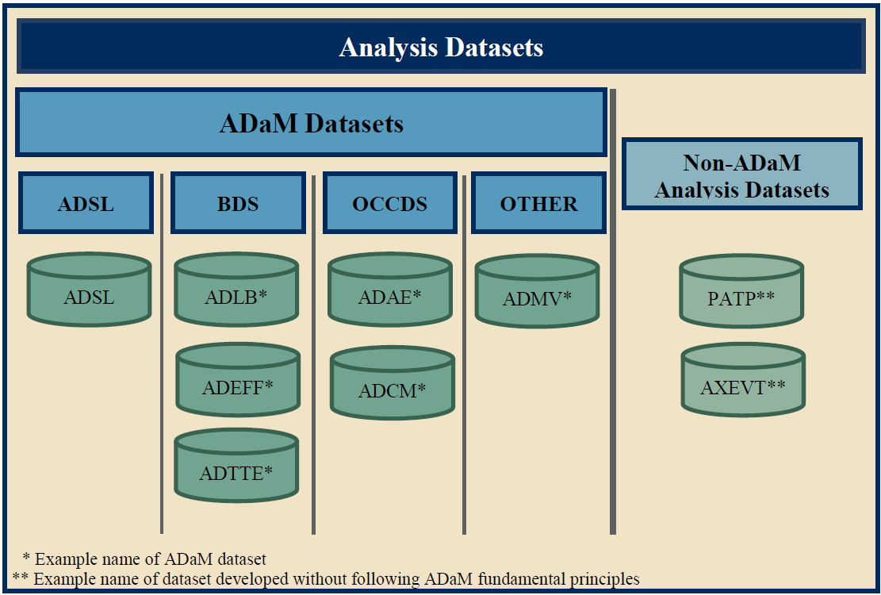
Categories of Analysis Datasets
Notes:
ADaM Structure for Occurrence Data (OCCDS)

Slide 12
Analysis Datasets - General Rules
A subject level dataset (ADSL) is required
Datasets should be included to cover all statistical analyses - no programming should be required by reviewers
ADaM standard naming of datasets: ADXXXXXX
If an SDTM variable is copied to ADaM, it must use the same name, label, etc.
A single dataset can support multiple analyses
No requirement for every SDTM to have an ADaM dataset
Redundancy in ADaM datasets may be necessary to facilitate analysis
Ordering of variables should follow a logical order

Slide 13
Analysis Dataset Structure
Three basic dataset formats:
Subject-Level Analysis Dataset - ADSL
One record per subject
Basic Data Structure - BDS
One or more record per subject, per analysis parameter, per analysis timepoint
Analysis timepoint is required if used
Includes variables to describe the analysis parameter
The value being analysed
Anything else needed for analysis
Variables to explain the derivation and traceability
ADaM Structure for Occurrence Data – OCCDS
Describes the general data structure and content typically found in occurrence analysis
Examples of data that fit this structure include Adverse Events, Concomitant Medications and Medical History

Slide 14
Analysis Dataset Structure
Sometimes non-standard data structures are needed:
Multivariate outcomes

Slide 15

Analysis Dataset Structure
ADaM dataset structures do not have counterparts in SDTM
Because the BDS tends toward a vertical design, some might perceive it as similar to the SDTM Findings class
BDS datasets may be derived from Findings, Events, Interventions and Special-Purpose SDTM domains, other ADaM datasets, or any combination thereof
Furthermore, in contrast to SDTM Findings class datasets, BDS datasets provide robust and flexible support for the performance and review of most statistical analyses

Slide 16
Values of ADaM “Core” Attribute
Req = Required. The variable must be included in the dataset
Cond = Conditionally required. The variable must be included in the dataset in certain circumstances
Perm = Permissible. The variable may be included in the dataset, but is not required
Unless otherwise specified, all ADaM variables are populated as appropriate, meaning nulls are allowed

Slide 17
Subject-Level Analysis Dataset (ADSL)
One record per subject
Provides variables that describe the attributes of the subject
Structure allows simple merging with other datasets
Required in all submissions
Endpoints that vary with time should not be included
Includes population flags and treatment variables
When merging with other datasets, only relevant variables should be included
If screen failures are included in other datasets, they must appear in ADSL

Slide 18
ADSL Variables
Minimum set of variables include:
Identifier variables (e.g. STUDYID, USUBJID, SUBJID)
Subject demographic variables (e.g. AGE, AGEU, RACE, SEX)
Population indicator variables
Treatment variables (e.g. ARM, TRTxxP)
Dose variables
Treatment timing variables
Subject-level period, sub-period, and phase-timing variables
Subject-level trial experience variables
Plus:
Disease Characteristics
Prognostic factors / covariates in analyses/used as randomisation strata
Notes:
Table 3.2.5 describes ADSL dose variables, which are used to describe dosage amount. These variables can only be used in addition to, not instead of, the ADSL treatment variables in Table 3.2.4. It is permitted to include dosing information in both the treatment variables and in the dosing variables.

Slide 19
ADaM Variable Naming - General
If the ADaM variable name is the same as in SDTM, the variable must be an exact copy from SDTM, and its label, meaning, and values must not be modified
ADaM adheres to a principle of harmonization known as “same name, same meaning, same values ”
To comply with SAS Version 5 transport file format:
Variable name no more than 8 chars, starts with a letter (not underscore) and contain only alphanumeric characters and underscore
Variable labels no more than 40 characters
Character variables no more than 200 characters in length

Slide 20
ADaM Variable Naming - General
The lower case letters “w”, “xx”, “y”, and “zz” that appear in a variable name or label must be replaced in the actual variable name or label using the following conventions:
“w” in a variable name (e.g., PHwSDT, PxxSwSDT) is an index for the w^{th} variable where “w” is replaced with a single digit [1-9]
“xx” in a variable name (e.g., TRTxxP, APxxSDT) refer to a specific period where “xx” is replaced with a zero-padded two-digit integer [01-99]
“y” in a variable name (e.g., SITEGRy) refers to a grouping or other categorization scheme, an analysis criterion, or an analysis range, and is replaced with an integer [1-99, not zero-padded]
“zz” in a variable name (e.g., ANLzzFL) are an index for the zz^{th} variable where “zz” is replaced with a zero-padded two-digit integer [01-99]
Notes:
The use of ‘xx’ within a variable name is restricted to the concept of a period.
“y” in a variable name (e.g., SITEGRy) refers to a grouping or other categorization scheme, an analysis criterion, or an analysis range, and is replaced with an integer [1-99, not zero-padded]. Truncation of the original variable name may be necessary in rare situations when a two digit index is needed and causes the length of the variable name to exceed 8 characters. In these situations, it is recommended that the same truncation be used for both the character and numeric versions of the variables in a variable pair.
“zz” in a variable name (e.g., ANLzzFL) are an index for the zz^{th} variable where “zz” is replaced with a zero-padded two-digit integer [01-99]. Note that the ‘zz’ convention represents a simple counter, while the ‘xx’ convention represents a specific period.
If an indexed variable is included in a dataset, there is no requirement that the preceding variable(s) in the sequence be included. For example, a dataset might include ANL02FL but not ANL01FL.

Slide 21
ADaM Variable Naming - General
When an ADaM standard variable name has been defined for a specific concept, the ADaM standard variable name must be used, even if the content of an ADaM variable is a direct copy of the content of an SDTM variable
For example, in the creation of ADLB, even if AVAL is just a copy of LBSTRESN the dataset must contain AVAL
Variable pairs designated as having a one-to-one mapping within e.g. a parameter
If both variables are present in the dataset there must be a one-to-one mapping between the two variables on all rows

Slide 22
ADaM Variable Naming - General
In a pair of corresponding variables (e.g. TRTP and TRTPN), the primary or most commonly used variable does not have the suffix or extension (e.g., N for Numeric or C for Character)
The relevant suffix is used only on the name of the secondary member of the variable pair, the primary variable, TRTP is character; but it is not named TRTPC
When the secondary variable is numeric, it can only be included if the primary variable is also present in the dataset
If both variables of a variable pair are present, there must be a one-to-one mapping between the values of the two variables, as described on the previous slide
Notes:
For example, in the (TRTP, TRTPN) pair, the primary variable, TRTP is character; but it is not named TRTPC. Similarly in the (APERIOD, APERIODC) pair, the primary variable, APERIOD, is numeric; but it is not named APERIODN. When the secondary variable is numeric, it can only be included if the primary variable is also present in the dataset. If both variables of a variable pair are present, there must be a one-to-one mapping between the values of the two variables, as described in Item 5 above.

Slide 23
ADaM Variable Naming - General
If SDTM character variables are converted to numeric variables in ADaM datasets, they should be named as they are in the SDTM with an “N” suffix added
e.g. the numeric version of the DM SEX variable is SEXN in an ADaM dataset
The secondary variable of the variable pair cannot be present in the dataset unless the primary variable is also present
The numeric equivalent of the variable cannot be present in the dataset unless the character version is also present
If necessary to keep within the 8-character variable name length limit, the last character may be removed prior to appending the N
Note: this does not apply to SDTM date/time character variables converted to ADaM numeric *DT, *TM, and *DTM variables.
Notes:
Note that this naming scheme applies only to numeric variables whose values map one-to-one to the values of the equivalent character variables.

Slide 24
ADaM Variable Naming - General
Variables whose names end in GRy, Gy, or CATy are grouping variables
“y” refers to the grouping scheme or algorithm (not the category within the grouping)
e.g, SITEGR3 is the name of a variable containing site group (pooled site) names, where the grouping has been done according to the third site-grouping algorithm; SITEGR3 does not mean the third group of sites.
CATy is the suffix used for categorization of ADaM-specified analysis variables (e.g., CHGCATy categorizes CHG)
Recommended that grouping or categorization variables begin with the name of the variable being grouped and end in GRy

Slide 25
ADaM Variable Naming - Timing
Numeric dates, times and datetimes should be formatted, so as to be human-readable with no loss of precision
Variables whose names end in:
DT are numeric dates
DTM are numeric datetimes.
TM are numeric times.
If a *DTM and associated *TM variable exist, then the *TM value must match the time part of the *DTM value when the *DTM variable is populated. If a *DTM and associated *DT variable exist, then the *DT value must match the date part of the *DTM value when the *DTM variable is populated

Slide 26
ADaM Variable Naming - Timing
Names of timing start variables end with an S followed by the characters indicating the type of timing (i.e., SDT, STM, SDTM)
Names of timing end variables end with an E followed by the characters indicating the type of timing (i.e., EDT, ETM, EDTM)
Variables whose names end in DY are relative day variables
In ADaM there is no day 0
If there is a need to create a relative day variable that includes day 0, then its name must not end in DY
ADaM relative day variables need not be anchored by SDTM RFSTDTC
Notes:
ADaM relative day variables need not be anchored by SDTM RFSTDTC. The anchor (i.e., reference) date variable must be indicated in the variable-level metadata for the relative day variable. The anchor date variable should also be included in ADSL or the current ADaM dataset to facilitate traceability. Similarly, anchor time variables used to calculate values for ADaM relative time variables must be indicated in the variable-level metadata for the relative time variable, and must be included in ADSL or the current ADaM dataset. Note that it is possible to have different definitions for a relative day (or time) variable (e.g., ADY) in separate datasets, using different anchor dates (or times). For example, the derivation of ADY for efficacy datasets might be different from that for safety datasets.

Slide 27
ADaM Variable Naming - Timing
The root or prefix (represented by *) ADaM date, time and datetime variable names must be chosen with care, to prevent unintended conflicts among other such names and standard numeric versions of possible SDTM variable names
One-letter prefixes
Two-letter prefixes, except when intentionally chosen to refer explicitly to a specific SDTM domain and its --DTC, --STDTC, and/or --ENDTC variables
Three-letter prefixes ending in S or E
In general, all three of *DT, *TM, *DTM are not required; include only those needed for analysis or review
However, when a *DTM variable exists, it is good practice to include a corresponding *DT variable
Notes:
cautioned that the root or prefix (represented by *) of such producer-specified supportive ADaM date, time and datetime variable names must be chosen with care, to prevent unintended conflicts among other such names and standard numeric versions of possible SDTM variable names. In particular, potentially problematic values for producer-defined roots/prefixes (*) include: a. One-letter prefixes. For an example of the problem, if * is Q, then a date *DT would be QDT; however, a starting date *SDT would be QSDT, which would potentially be confusing if the producer intended QSDT to be something other than the numeric date version of the SDTM variable QSDTC.
b. Two-letter prefixes, except when intentionally chosen to refer explicitly to a specific SDTM domain and its --DTC, --STDTC, and/or --ENDTC variables. For an example of an appropriate intentional use of a two-letter prefix, if * is LB, then *DT is LBDT, the numeric date version of SDTM LBDTC. For an example of the problem, if * is QQ, then a date *DT would be QQDT, which would potentially be confusing if the producer intended QQDT to be something other than the numeric date version of a potential SDTM variable QQDTC.
c. Three-letter prefixes ending in S or E. For an example of the problem, if * is QQS, then a date *DT would be QQSDT, which would potentially be confusing if the producer intended QQSDT to be something other than the numeric date version of a potential SDTM variable QQSTDTC.

Slide 28
ADaM Variable Naming - Timing
Date and Time Imputation Flag Variables
When a date or time is imputed, require a date or time imputation flag variable
The variable fragments to be used for these variables are DTF and TMF
The root of the variables should be identical
*DTF variables represent the highest level of imputation of the *DT variable based on the source SDTM DTC variable
*DTF = Y if the year is imputed
*DTF = M if year is present and month is imputed
*DTF = D if only day is imputed
*DTF = null if *DT equals the SDTM DTC date part

Slide 29
ADaM Variable Naming - Timing
*TMF variables represent the level of imputation of the *TM (and *DTM) variable based on the source SDTM DTC variable
*TMF = H if the entire time is imputed
*TMF = M if minutes and seconds are imputed
*TMF = S if only seconds are imputed
*TMF = null if *TM equals the SDTM DTC time part
If only hours and minutes are ever collected, and seconds are imputed in *DTM as 00, then it is not necessary to set *TMF to “S”

Slide 30
ADaM Variable Naming - Flags
All character flags end in FL, numeric flags in FN
The terms “flag” and “indicator” are used interchangeably, and “flag variables” are sometimes referred to simply as “flags.”
Population flags must be included for the analysis population
A character indicator variable is required for every population that is defined in the statistical analysis plan
All applicable subject-level population flags must be present in ADSL
Null values not allowed for population flags (i.e. Set to “N”)
Null values are allowed in other flags (can either use Y/null or Y/N/null - should be specified)
Notes:
If the flag is included in an ADaM dataset, the character version (*FL) is required but the corresponding numeric version (*FN) can also be included. If both versions of the flag are included, there must be a one-to-one mapping between the values of the two variables

Slide 31
Actual and Planned Treatment
Assigned treatment is stored in SDTM in DM.ARM
Planned treatment should be stored in TRTxxP (xx=period)
In a one period study, TRT01P = DM.ARM
Where actual treatment is not always planned treatment, TRTxxA is required

Slide 32
ADSL Exercise
In EXCEL, create a list of all ADSL variable names from the example study, making a note of the origin of the SDTM variables used.

Slide 33
Basic Data Structure Definitions
Analysis parameter – A row identifier used to uniquely characterize a group of values that share a common definition
Analysis timepoint – A row identifier used to classify values within an analysis parameter into temporal or conceptual groups used for analyses
Analysis value
The numeric (AVAL) or character (AVALC) value described by the analysis parameter
In addition, values of certain functions are considered to be analysis values
Parameter-variant – A column that is derived as a function of AVAL (or AVALC) is parameter-variant if it is calculated differently for some parameters for which the variable is populated in a dataset
Parameter-invariant – A column that is derived as a function of AVAL (or AVALC) is parameter-invariant if it is calculated the same way for all parameters for which the variable is populated in a dataset
Notes:
Analysis parameter – A row identifier used to uniquely characterize a group of values that share a common definition. Note that the ADaM analysis parameter contains all of the information needed to uniquely identify a group of related analysis values. In contrast, the SDTM --TEST column may need to be combined with qualifier columns such as --POS, --LOC, --SPEC, etc., in order to identify a group of related values. Example: The primary efficacy analysis parameter is “3-Minute Sitting Systolic Blood Pressure (mmHg).” In this document the word “parameter” is used as a synonym for “analysis parameter.”
Analysis timepoint – A row identifier used to classify values within an analysis parameter into temporal or conceptual groups used for analyses. These groupings may be observed, planned or derived. Example: The primary efficacy analysis was performed at the Week 2, Week 6, and Endpoint analysis timepoints.
Analysis value – (1) The numeric (AVAL) or character (AVALC) value described by the analysis parameter. The analysis value may be present in the input data, a categorization of an input data value, or derived. Example: The analysis value of the parameter “Average Heart Rate (bpm)” was derived as the average of the three heart rate values measured at each visit. (2) In addition, values of certain functions are considered to be analysis values. Examples: baseline value (BASE), change from baseline (CHG).
Parameter-variant – A column that is derived as a function of AVAL (or AVALC) is parameter-variant if it is calculated differently for some parameters for which the variable is populated in a dataset.
Parameter-invariant – A column that is derived as a function of AVAL (or AVALC) is parameter-invariant if it is calculated the same way for all parameters for which the variable is populated in a dataset. Thus, a column is parameter-invariant if how it is derived does not depend on which parameter is on the row. The parameter-invariant derivation remains the same across all parameters, though it may be left null for parameters where it does not apply. For example, the derivation for the change from baseline variable is CHG=AVAL-BASE, an equation that is the same for all parameters. CHG is therefore a parameter-invariant variable. The concept of parameter invariance is essential to the integrity of the BDS because it is an integral component in the rules defined in Section 4.2 that prohibit “horizontalization” (creation of new columns when the model dictates that a new row is required instead) by producers.

Slide 34
Basic Data Structure (BDS)
A BDS dataset contains one or more records per subject, per analysis parameter, per analysis timepoint
Includes the ADSL variables required to enable analysis or support traceability
Typically there are several BDS datasets in a study

Slide 35
Basic Data Structure - Subject Identifiers
STUDYID and USUBJID are both required
SUBJID/SITEID - required in ADSL, permissible in other datasets

Slide 36
BDS - Treatment
Treatment is assigned at the record level
TRTP is only required variable (note difference in name from ADSL)
TRTA is required if data are analysed by actual treatment and subjects in the study did deviate from the planned treatment
TRTAN/TRTPN permissible
Treatment pooling variables permissible

Slide 37
BDS – Dose Variables
All variables in this section are permissible
The record-level dose variables, plus subject-level dose variables copied from ADSL, can be used in addition to, but not instead of, treatment variables

Slide 38
BDS- Timing
Variables used to classify values into time intervals for analysis
May be observed, planned or derived
Any SDTM timing variable may be copied to ADaM
Analysis timing variables start with “A”, e.g. ADT, ATM, ADY, ASTDT, AENDT
AVISIT may be a copy of SDTM.VISIT, derived or windowed visits, conceptual descriptions (e.g. endpoint)
Lots of potential options - see ADaM IG

Slide 39
Basic Data Structure - Parameter
PARAM/PARAMCD (required)
The description of the analysis parameter
PARAM should be sufficient to describe unambiguously the contents of AVAL/AVALC
PARAM must include all descriptive and qualifying information relevant to the analysis purpose of the parameter
Examples of qualifying information that might be relevant to analysis:
Units
Specimen type
Location
Position
There is no need to include qualifiers that are not relevant to the analysis of PARAM

Slide 40
Basic Data Structure - Parameter
PARAM/PARAMCD (required)
PARAM may be longer than 40 characters in length but is restricted to a maximum of 200 characters
PARAM is often directly usable in Clinical Study Report displays
Note that in the ADaMIG, “parameter” is a synonym of “analysis parameter”
PARAMCD is the short name of the analysis parameter in PARAM
Must be a 1:1 mapping to PARAM within a dataset
PARAMN can be used for ordering
Variables available for grouping (e.g. AVALCATx)
CRITx - analysis criterion - specifies pre-defined criterion

Slide 41
BDS- Analysis Values
AVAL/AVALC
The result described by the parameter
May be source data, categories, or derived
Conditional variables, but at least one of AVAL and AVALC must be present in the dataset
AVALC can be a character string mapping to AVAL with a one-to-one map between AVAL and AVALC within a given PARAM
AVALC should not be used to categorize the values of AVAL
On a given record, it is permissible for AVAL, AVALC, or both to be null
Other variables are also analysis values, e.g. BASE, CHG, PCHG
Notes:
For most parameters, only AVAL or AVALC will be populated, not both. That both --STRESC and --STRESN are present and populated in SDTM Findings class domains does not imply that both AVAL and AVALC must be present and populated in BDS datasets. AVAL and AVALC have a different purpose than --STRESN and --STRESC. For example, for parameters corresponding to numeric tests in SDTM Findings class domains, it is not recommended to copy SDTM --STRESC into AVALC, because there is no analysis need for a character value. Furthermore, doing so may result in breaking the one-to-one mapping requirement in some cases. If it is desired for traceability or listing purposes to bring the value of --STRESC into the ADaM dataset, the variable --STRESC may be copied as is without renaming it.

Slide 42
Derived parameters and records
DTYPE - derivation type (e.g. LOCF, AVERAGE)
Required when AVAL/AVALC has been derived or calculated
PARAMTYP is used to denote when an entire parameter has been derived; DTYPE when a record has been derived

Slide 43
Flags
ABLFL - set to “Y” for the baseline record
ABLFL is required if BASE is present in the dataset
ABLFL may not necessarily match SDTM baseline flags – see ADaM IG 1.1 Section 3.5
ANLxxFL - supports the selection of records for analysis (e.g. which record within a time window is to be used in the analysis)
ONTRTFL - to indicate an observation occurred during treatment
CRITxFL - whether the criterion in CRITx was fulfilled
Lots of others - see ADaM IG

Slide 44
New Variable vs New Parameter?
A function of AVAL and BASE that is the same across all parameters can be added as a new variable (e.g. CHG)
Any other AVAL transformation should be added as a new parameter (e.g. logarithmic analysis)
Any function of one or more rows within a parameter should be added as a new parameter (e.g. LOCF record, average)
A function of more than one parameter should be added as a new parameter (e.g. BMI in vital signs)
More than one definition of baseline required multiple rows

Slide 45
BDS Exercise 1
Create an ADaM dataset for the lab assessments that could be used to generate a summary table of lab data. Assume that lab data are windowed programmatically, and change from baseline is needed. Baseline is defined as the last non-missing value before treatments starts and a screening value can be used where a baseline result is not available.

Slide 46
ADaM Structure for Occurrence Data (OCCDS)
Occurrence analysis is the counting of subjects with a given record or term
Often includes a structured hierarchy of dictionary coding categories
Examples of data that fit into this structure include those used for typical analysis of Adverse Events, Concomitant Medications, and Medical History

Slide 47
ADaM Structure for Occurrence Data (OCCDS)
This data analysed using SDTM plus added analysis variables
There is no need for AVAL or AVALC
A dictionary is often used for coding the occurrence and typically includes a well-structured hierarchy of categories and terminology
Re-mapping this hierarchy to BDS variables PARAM and generic *CAT variables would lose the structure and meaning of the dictionary

Slide 48
ADaM Structure for Occurrence Data (OCCDS)
The data content is typically not modified for analysis purposes
There is no need for analysis versions of the variables that hold the dictionary hierarchy or category terms

Slide 49
ADaM Structure for Occurrence Data (OCCDS)
Usually one record per record in the corresponding SDTM domain
Should be “analysis-ready,”
Dataset should contain all of the variables needed for the specific analysis
This ADaM model primarily discusses the creation of an analysis dataset that is needed for the presentation of frequencies and percentages
Notes:
Dataset should contain all of the variables needed for the specific analysis, so that the analysis can be replicated by performing the actual statistical test without first having to manipulate data
This ADaM model primarily discusses the creation of an analysis dataset that is needed for the presentation of frequencies and percentages. However, the analysis datasets presented here could be used to construct more in-depth analysis dataset, even in a different structure. For time-to-event analyses, see the ADaM Basic Data Structure for Time to Event Analyses appendix.

Slide 50
ADaM Structure for Occurrence Data (OCCDS)
Include all variables from the SDTM dataset and corresponding supplemental qualifiers that are needed for analysis or traceability
ADSL variables
Include any required for analysis or reference
Identifier variables (from SDTM)
STUDYID, USUBJID, --SEQ
Dictionary coding variables (from SDTM as required)

Slide 51
ADaM Structure for Occurrence Data (OCCDS)
Timing variables
Copied from SDTM
Derived within ADaM
Indicator variables
If present in SDTM and pertinent for analysis
OCCDS Indicator variables
ANLzzFL

Slide 52
ADaM Structure for Occurrence Data (OCCDS)
Indicator variables
Adverse Events
TRTEMFL – derived in ADaM dataset
AETRTEM – copied from SDTM dataset
Concomitant Medications
ONTRTFL – derived in ADaM dataset
AE and CM
PREFL and FUPFL

Slide 53
ADaM Structure for Occurrence Data (OCCDS)
Occurrence flags can be used to prepare data for analysis
Typically created by sorting the data in the required order and then flagging the first treatment emergent record
The more common occurrence flags and a structure for additional flags are shown in ADaM_OCCDS_v1.0, section 3.6
Notes:
They are typically created by sorting the data in the required order and then flagging the first treatment emergent record. The use of the word “first” in this section doesn’t necessarily mean chronological, though that is an option

Slide 54
ADaM Structure for Occurrence Data (OCCDS)
Treatment/dose variables
The treatment variable used for analysis must be included
Typically this would be TRTP, TRTA, TRTxxP, or TRTxxA
Descriptive variables
Include Variables that describe the record and any other SDTM variables if used in analysis
If the analysis version of the variable differs from the version in SDTM, additional variables must be added
Standardized MedDRA Query variables

Slide 55
Metadata requirements
Underlying assumptions, statistical methods, transformations, derivations and imputations should be communicated clearly to enable the results to be easily reproduced
ADaM metadata facilitates this by providing details and links between analysis descriptions (e.g. SAP), results, analysis data and the SDTM domains.
CDISC has defined the documentation standards (on their website)

Slide 56
Dataset Metadata Details
Metadata field | Description
Dataset Name | File name of dataset with hyperlinks to variable definitions
Description | Descriptive summary of the dataset
Location | Folder and filename to the actual dataset (hyperlinks)
Structure | e.g. One record per subject per visit
Key Variables | Variables that uniquely identify each record
Class | General class of dataset e.g. “ADSL”, “BDS”
Documentation | Details including source data, processing steps, analysis decisions. May include code fragments and links to external documentation

Slide 57
Variable Metadata Details
Metadata field | Description
Dataset Name | File name of dataset with hyperlinks to variable definitions
Variable Name | Name of variable
Label
Type
Display format | SAS Format used in presentation of results
Codelist/ Controlled Terms | List of valid values (may be a hyperlink)
Source/ Derivation | Provide details of where the variable originated or how the variable was derived. Source can be a two level name (e.g. ADSL.AGE).
Parameter Identifier | ALL/DEFAULT/value of PARAMCD

Slide 58
Analysis Results Metadata
Describe major attributes of an analysis result
Provides a link between results and data
Only needed where necessary to explain analysis
Not recommended for all results

Slide 59
Analysis Results Metadata
Metadata field | Description
Display identifier | Unique number relating to output
Display Name | Title of display
Result identifier | Identifies the specific result within a display
Param & Paramcd
Analysis variable
Reason | Rationale for performing the analysis. E.g. “Pre-specified in protocol”
Dataset
Selection criteria | Where clause applied to source data
Documentation | Textual description
Programming statements | Programming code used to perform the analysis

Slide 60
Analysis Results Metadata Exercise
Create a set of metadata documentation for the ADSL dataset.
Create a set of metadata documentation for the ADaM lab dataset.

Slide 61
Not covered
Implementation Issues, Standard Solutions, and Examples – section 4
ADaM Structure for Occurrence Data (OCCDS) Version 1.0
Anything relating to define.xml

